Slide 1
7th and 8th Grade
Parent Information Night
Hendrick Middle School
January 2019

Slide 2
Hendrick Middle School Administration
Lisa Long Principal
Adrienne Hunter Assistant Principal
Mark Wilczynski Assistant Principal

Slide 3
Hendrick Middle School Counselors 2019-2020
Denise Menard 6th grade
Victoria Hines 7th grade
Sally Villani 8th grade

Slide 4
Course Requirements
English
Math
Social Studies
Science
PE or Athletics (1 or 2 semesters)

Slide 5
7th/8th Grade Honors Classes
Honors English
Honors Science – independent science research requirement

Slide 6

Math
Math 6 Math 7
Math 6H Math 7H
Math 6 Math 7H
Student now meets the Math 7 Honors Profile. They will need to complete the PISD Bridge Work via the internet during the 2019 summer. A math competency exam will be given prior to the school year start.

Slide 7
Math
Math 7 Math 8
Math 7H Algebra I H
Math 7 Algebra I H
Student now meets the honors profile or is now interested in Algebra I H in 8th grade. This will require the completion of the Math 8 Credit By Exam (CBE) during Summer 2019.
Forms Available in Counseling Center.

Slide 8
Math
  Algebra I H Geometry H @Vines Academy

Slide 9
Reading 7th and 8th Grades
  Accelerated Reading – year course
  Placement decisions will be made at the end of the school year based on individual student needs.

Slide 10
Year Long Electives
Fine Arts – Band , Choir and Orchestra *
Athletics
Spanish I, Part I – 7th grade
Spanish I, Part II – 8th grade
French (Vines Academy) – 8th grade only
*Band, Choir and Orchestra require teacher initials

Slide 11
Semester Electives
Art 1: Intro. to Art – 7th & 8th
Art 2: 2D – 7th & 8th
Art 2: 3D – 7th & 8th
Art 3: Advanced Art – 8th
Exploring Information & Computer Technology – 7th & 8th
Investigating Arts, AV and Communications – 7th & 8th
Gateway to Technology – 8th (0.5 HS credit)
Health – 8th grade (0.5 HS credit)
Speech I Public Speaking – 7th & 8th
Speech II Debate Intro. – 7th & 8th
Theater Arts I – 7th & 8th
Theater Arts II – 7th & 8th

Slide 12
Credit By Exam
Foreign Languages
American Sign Language I American Sign Language II
Arabic Chinese - Simplified
Filipino French
German Hebrew
Hindi Italian
Japanese Russian
Spanish Vietnamese Yup'ik

Slide 13
PE / Athletics
All students must take 4 semesters of PE/Athletics before leaving 8th grade.
Off Campus PE – applications will be available online or in the counseling office in May 2019.
Students may take a regular PE class or participate in athletics to meet this requirement.
Students interested in Partner’s PE should contact Coach Doherty or Coach Adams.

Slide 14
PE/Athletics
Semesters
6th - 2
7th - 1 or 2
8th - 1 or 2
Total must equal 4
Everyone must take at least one semester of PE in 7th grade.

Slide 15
7th Grade Boys Athletics
1st Period
Anyone who signs up for the 1st semester will play football.
Basketball players who tryout and make the basketball team who are not currently in athletics will be added. Once the basketball season is over they will actively participate in all off-season workouts.
During the off season this period will be preserved for off season workouts and will focus on strength/conditioning and sport specific drills.

Slide 16
7th Grade Girls Athletics
1st Period
Current 6th grade girls have completed an evaluation process for athletics next year. These top 50 girls will be added to athletics at the beginning of the year.
There will be tryouts for volleyball and basketball.
Tryouts will occur before the school day and tryout dates/times will be posted and announced. Any student may try out for a sport, regardless if they are in athletics or not. Any student that makes the team and is not enrolled in Athletics will be added.
During the off season, this period will be preserved for training sessions and will focus on strength/conditioning and sport specific drills.

Slide 17
8th Grade Boys Athletics
8th Period
Anyone scheduled into athletics 1st semester will play football with the exception of the 7th basketball players that made the 7th grade team and did not play football.
Basketball players who tryout and make the basketball team who
are not currently in athletics will be added. Once the
basketball season is over those students will actively
participate in all off-season workouts.
During the off season this period will be preserved for off-season workouts and will focus on strength/conditioning and sport specific drills.

Slide 18
8th Grade Girls Athletics
8th Period
Only girls who were on the 7th grade Volleyball or Basketball teams will be scheduled for athletics during the registration process if they so choose.
Volleyball and Basketball tryouts will be held prior to each season.
Players will participate in the off-season workouts unless they make a team, at which time they will focus on that sport during the respective season.
Players who tryout and make the team who are not currently in athletics will be added. Once the volleyball or basketball season is over those students will also actively participate in all off-season workouts.

Slide 19
Athletics Requirements
A Physical examination is required by UIL before a student is allowed to participate in athletics. This includes tryouts or practice.
Must maintain 70 or above in all subjects to be eligible to participate: NO PASS, NO PLAY

Slide 20
ATHLETICS
ANY changes into or out of athletics will be made on an individual basis and will deal with any issues pertaining to that student at the time.
Any changes will impact the electives, class times and teachers you have. It will disrupt your schedule, and you may not have control over elective changes.

Slide 21
Hendrick Track Team
  The Hendrick Track Team will be an after school opportunity.
  Any 7th or 8th grade student is welcome to join the Hendrick Track Team.
  Practices will occur after school. Practice for the track events will not occur during the athletic periods!

Slide 22
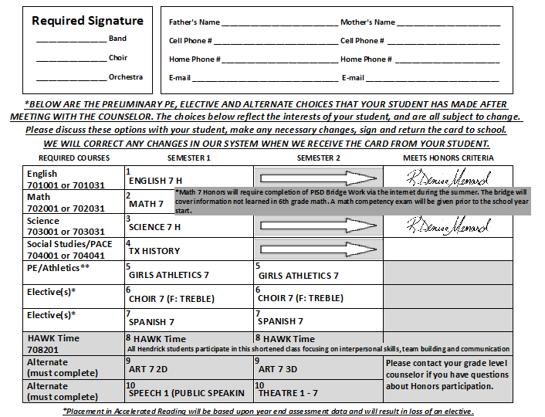
If a student is currently in honors or shows that they are a strong candidate for an honors class, the counselor’s signature will be found in this section.*

Slide 23
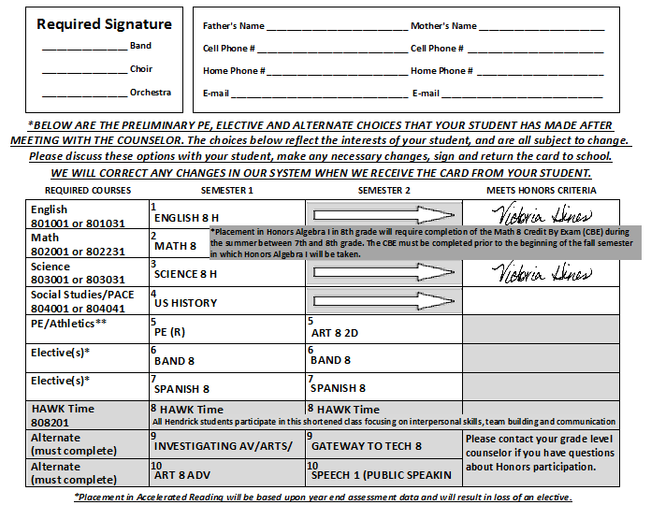
If a student is currently in honors or shows that they are a strong candidate for an honors class, the counselor’s signature will be found in this section.*

Slide 24
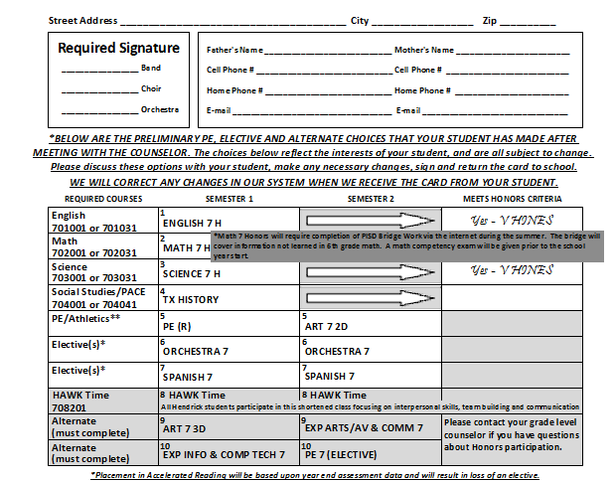

Slide 25
Points to Remember . .
Cards will be distributed to the students on Friday, February 1st.
Fill in all information at the top of the card.
The choices will reflect the interests of your student.
Please make any necessary changes on the registration card by drawing a single line through the class you no longer want and write in the new class.

Slide 26
Points to Remember . .
Please remember to sign the card before you turn it in.
Cards will be due on Wednesday, Feb.6th to your student’s Science teacher.
https://www.pisd.edu/coursecatalogs

